Slide 1
DNS
CS 168 – Spring 2020 – Section 10
Notes:
Slides by Ankit Mathur

Slide 2
Agenda
The Domain Name System (DNS)
Purpose
Records
Lookups
Caching

Slide 3
DNS
Map a name to an IP
Generally: key-value map
Goals
Replacement for HOSTS.TXT
Fully distributed maintenance
Tolerable performance

Slide 4
DNS
Domains delegate to subdomains (forming a tree).
To find eecs.berkeley.edu:
Ask . (root)
→ .edu (TLD servers)
→ berkeley.edu (domain servers)
→ eecs.berkeley.edu - authoritative server!

Slide 5
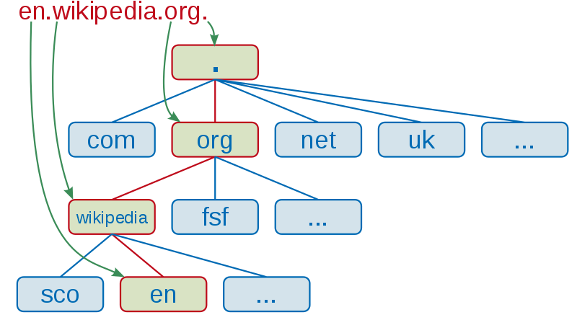
DNS name server delegation
Walk through address hierarchy, based on domain name
Source: Wikipedia (https://commons.wikimedia.org/wiki/File:DNS_schema.svg)

Slide 6
DNS root name servers
13 root server addresses:
a.root-servers.net (198.41.0.4)
...
m.root-servers.net (202.12.27.33)
How do 13 servers handle all DNS root queries?
Multiple replicates, all with the same IP
How do we route to different servers with the same IP?

Slide 7
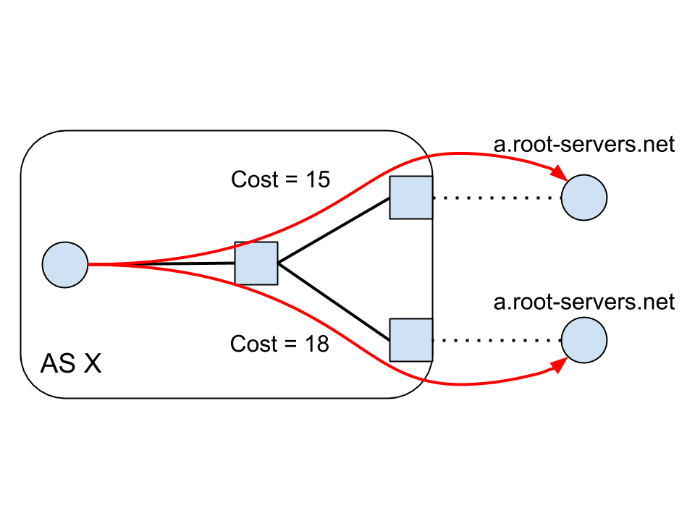
Anycast
Route to any host with this address.
Route to A (cost 15)
Route to A (cost 18)
Looks like route to same host with different cost!
(Implemented with cost preferences in BGP.)
* Normal one-to-one IP routing is unicast routing.

Slide 8
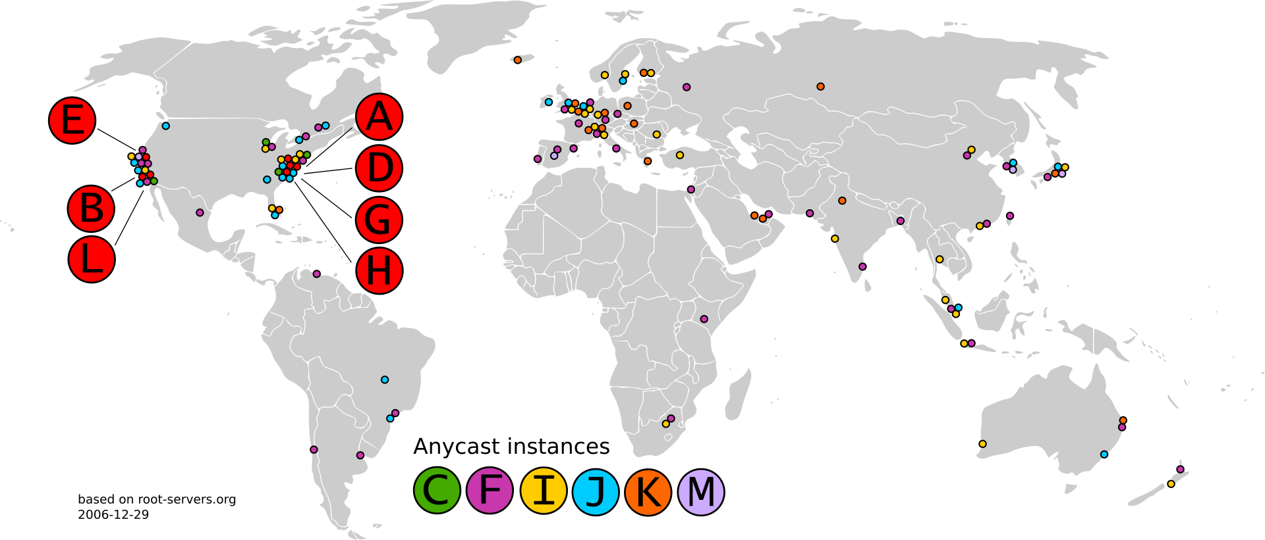
Root server locationing
Source: Wikipedia (https://commons.wikimedia.org/wiki/File:Root-current.svg)

Slide 9
Resource Record Types
NS | name server | delegate lookups to name server
A | address (IPv4)
AAAA | address (IPv6)
CNAME | canonical name | redo lookup with provided name
MX | mail exchanger | mail server (@gmail.com, etc.)
TXT | text | verification, notes, machine-readable data...
SRV | service | general services
... |  | (security, keys, location, ...)

Slide 10
Typical DNS Query
root servers
Where is www.wikipedia.org?
Ask .org server at 1.2.3.4
Where is www.wikipedia.org?
Resolving server
.org servers
Ask wikipedia.org server at 5.6.7.8
Where is www.wikipedia.org?
Where is www.wikipedia.org? (recursive)
.wikipedia.org servers
Client
Answer: 9.10.11.12
Notes:
DNS client requests www.google.com

Slide 11
Caching DNS Responses
DNS server
(mydns.berkeley.edu)
DNS responses cached in servers
Expire after TTL (time-to-live)
Most popular sites visited often
Top sites frequently cached. Fast!
www.google.com
IP: Z
DNS client (me.cs.berkeley.edu)
Hostname | IP | TTL
www.google.com | Z | 60 min

Slide 12
Note: recursive queries
Most queries are iterative: the response is either
An answer (A, MX, ...)
A referral to another nameserver (NS)
In a recursive query, the server does the full query for you.
Clients do less work
ISPs can cache better
Large CDNs can offer faster resolution
Google, Cloudflare, Cisco, ...

Slide 13
DNS Lookup
root servers
Where is www.wikipedia.org?
Where is www.wikipedia.org?
DNS server
9.10.11.12
9.10.11.12
.org servers
Answer: 9.10.11.12
Where is www.wikipedia.org?
Where is www.wikipedia.org?
.wikipedia.org servers
DNS client
This kind of query isn’t actually possible. Why?
Notes:
Meta: when might you want a recursive DNS lookup? Is it more performant?
(i.e. may want recursive for cloud DNS services like Google’s, Cloudflare’s DNS, may not want it for heavy loads like root servers.)

Slide 14
Worksheet

Slide 15
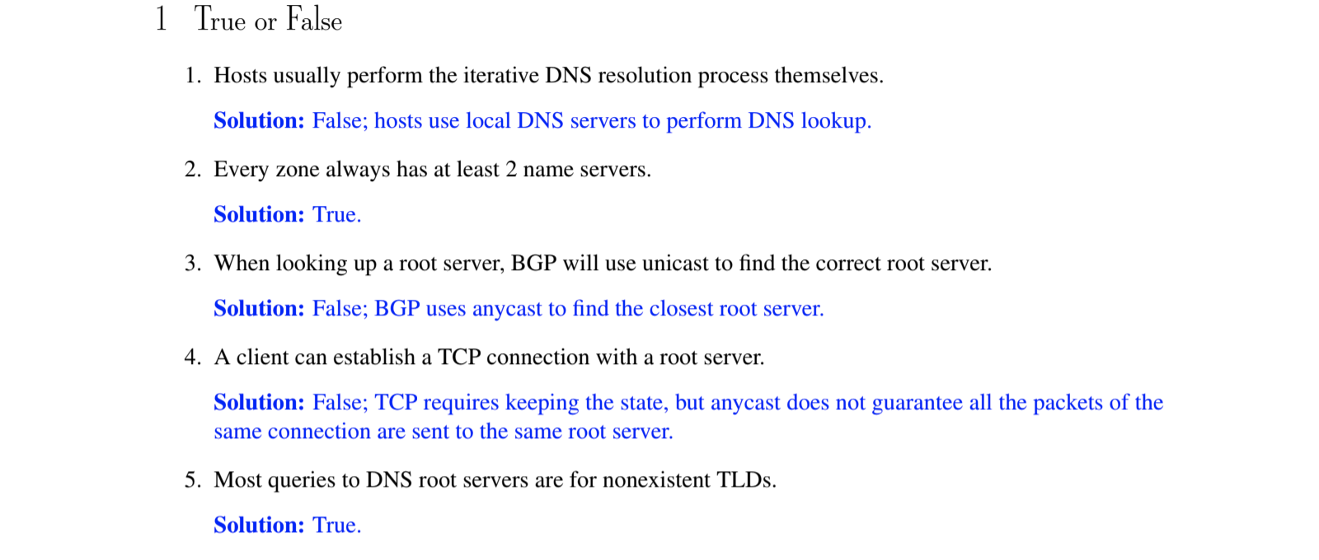
Q1
Notes:
False, True, False, False, True

Slide 16
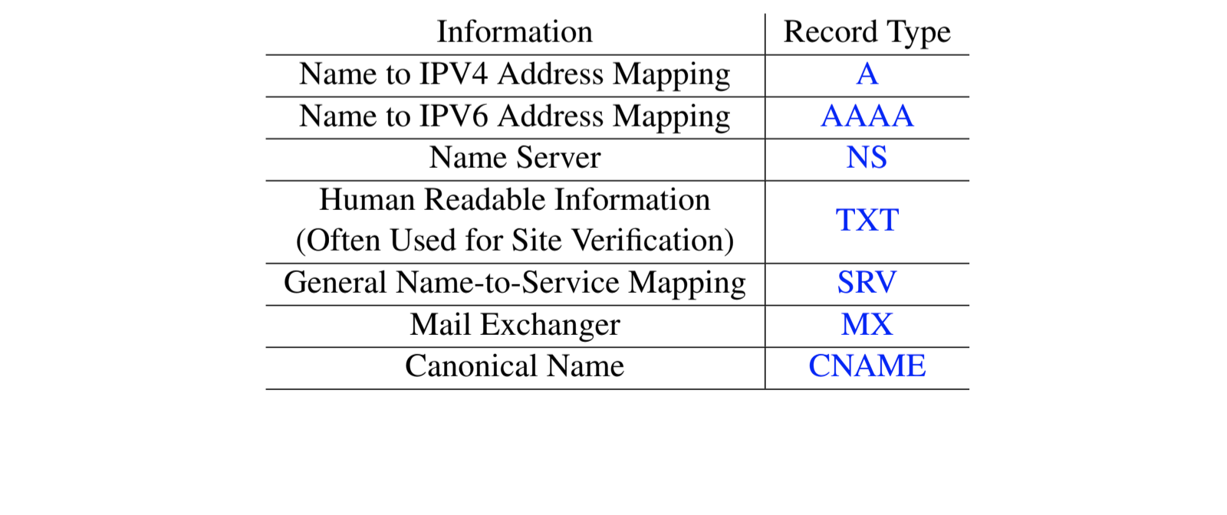
Q2
Notes:
A,AA, NS, TXT, SRV, MX, CNAME

Slide 17

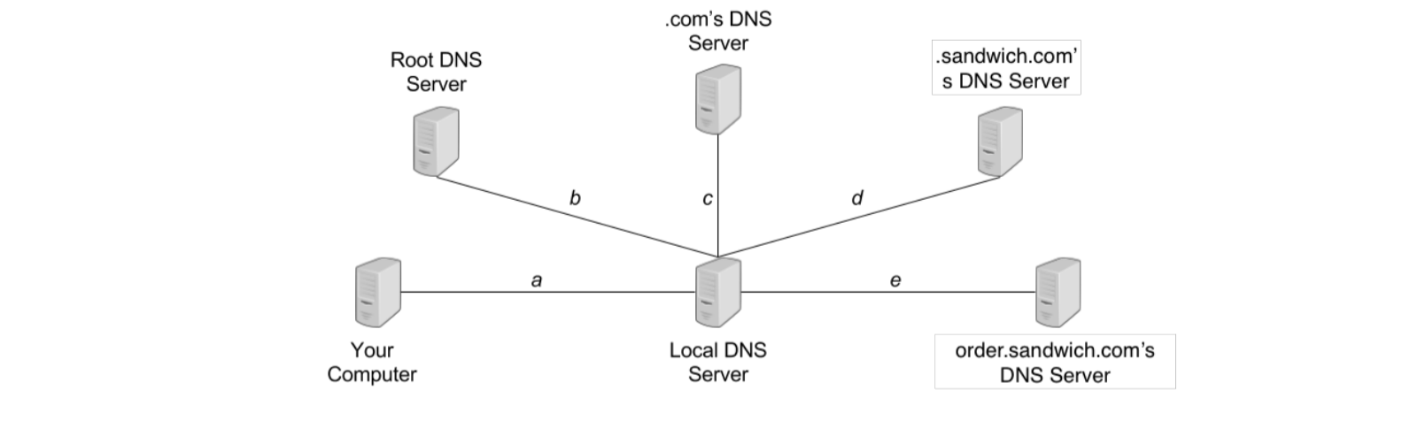
Q3

Slide 18
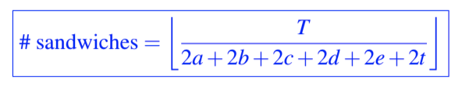
Q3

Slide 19
Q3

Slide 20
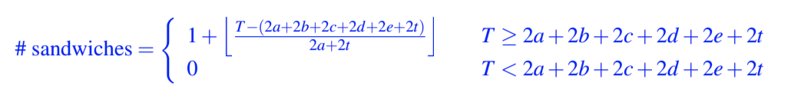
Q3

Slide 21
Q3

Slide 22
Q3
Requests completed at 12, 16, 20, 24, 28, 32, 36, 40 seconds
This is repeated 15 times 15* 8 = 120 sandwiches

